Slide 1
CSS Retirement Savings Plan

Slide 2
A New Retirement Plan
Open to all employees (including contractors)
Access to financial education and training
24/7 access to online tools and videos
Direct access to a financial advisor

Slide 3
Need Assistance? Call us…
PCS
Includes enrollment and transaction initiation (including transfers, loans and distributions)
Participant Call Center available 24 hours per day
CLA Wealth Advisors
Available for plan design and investment related questions
Your FIRST point of contact
267-419-1651
888-621-5491

Slide 4
Plan Highlights
Eligibility Requirements
Attain age 21
1 year of service, AND
Completion of 1,000 hours of service
Enrollment Period
First day of the plan quarter after meeting eligibility requirements
Employer Match
$.50 on $1.00 up to 4% match
IRS Contribution Limits – 2020
$19,500
$6,500 catch up (over 50 years old)

Slide 5
Next Steps
December 2019: Enrollment into the PCS platform begins
Enrollment ends January 2, 2020
January 2020: PCS plan becomes active
1st payroll with ADP includes existing deductions
2nd payroll with ADP includes new deductions
Employee must enroll in new plan to continue deductions
Blackout Period: (Expected to take place on 1/17/20 to 2/21/20)
During the blackout period, you will not have access to view your old plan at BCG
Plan assets held at BCG will be liquidated and transferred to PCS
There is nothing required of you to process this transfer – this will be handled by PCS

Slide 6
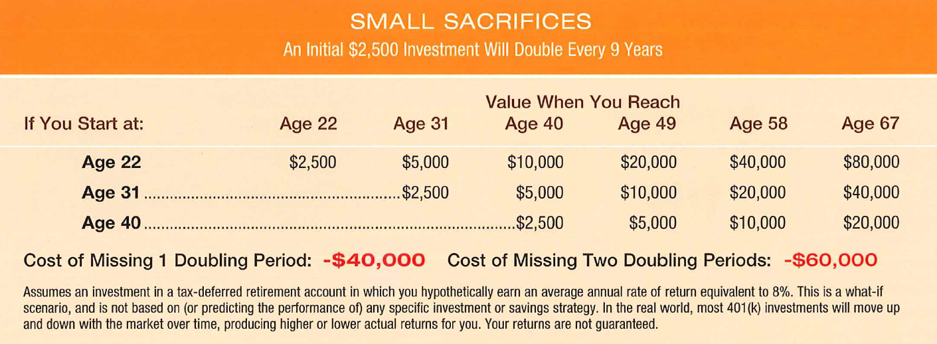
Why Save NOW?

Slide 7
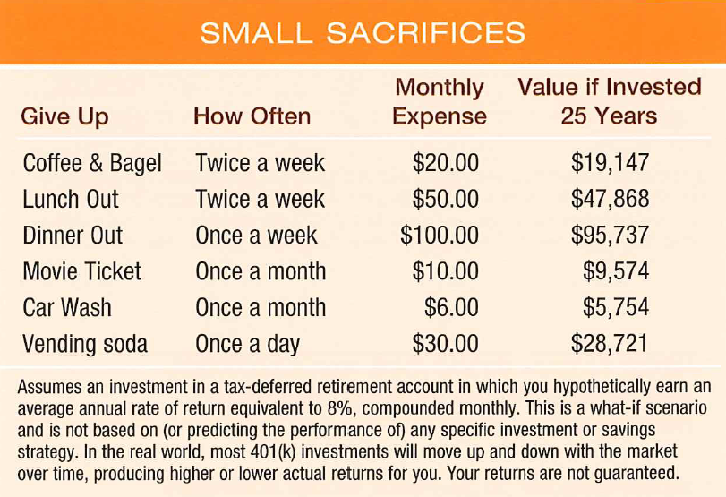
Spending Versus Saving

Slide 8
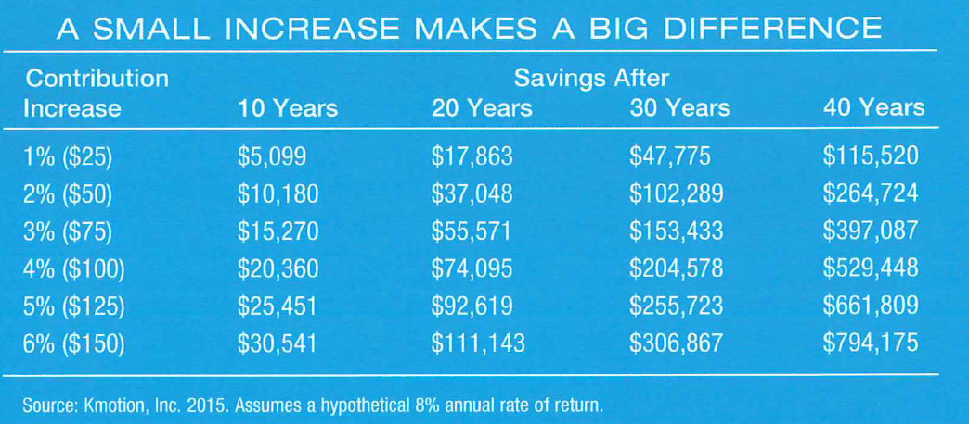
Rule of Thumb

Slide 9
Focus On The Long Term

Slide 10
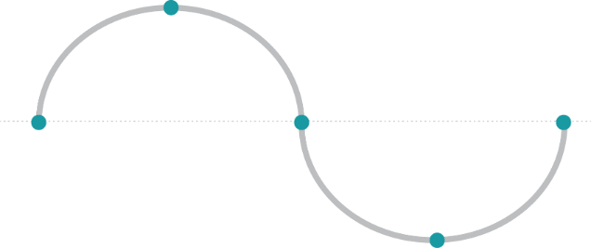
Manage Your Emotions
SC: LC21
Pursuing a Better Investment Experience
Daily market news and commentary can challenge your investment discipline. Some messages stir anxiety about the future while others tempt you to chase the latest investment fad.
When tested, consider the source and maintain a long-term perspective.
Reactive Investing in a Market Cycle
HIGHER PRICES
Elation
Optimism
Optimism
Nervousness
Fear
LOWER PRICES
Many people struggle to separate their emotions from investing. Markets go up and down. Reacting to current market conditions may lead to making poor investment decisions at the worst times.
For illustrative purposes only.
Notes:
The idea behind investing is to buy low and sell high. Yet, following an emotional investment cycle sparked by reactive decisions may bring the opposite effect: buying at higher prices and selling at lower prices.
The 2008–09 global market downturn offers an example of how the cycle of fear and greed can drive an investor’s decisions. Some investors fled the market in early 2009, just before the rebound began. They locked in their losses and then experienced the stress of watching the markets climb.
Staying disciplined through rising and falling markets can pose a challenge, but it is crucial for long-term success.

Slide 11
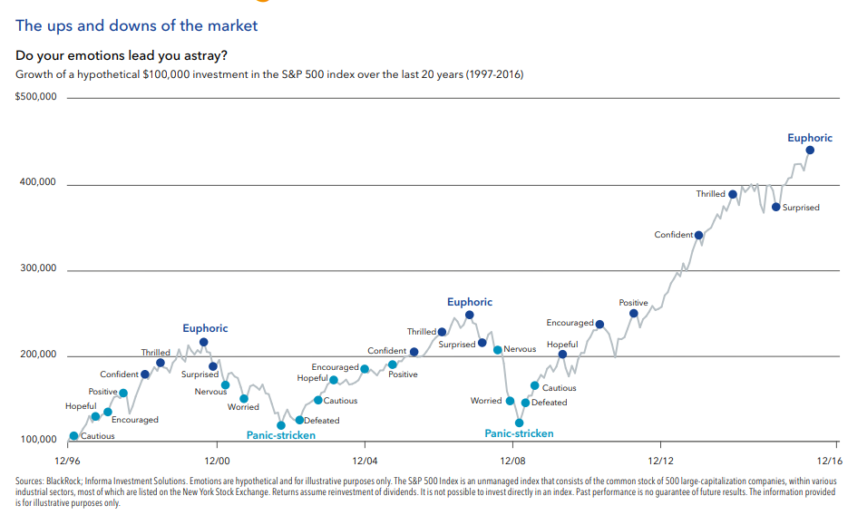
Investing and Emotions

Slide 12
Ranges of Returns Over Time

Slide 13
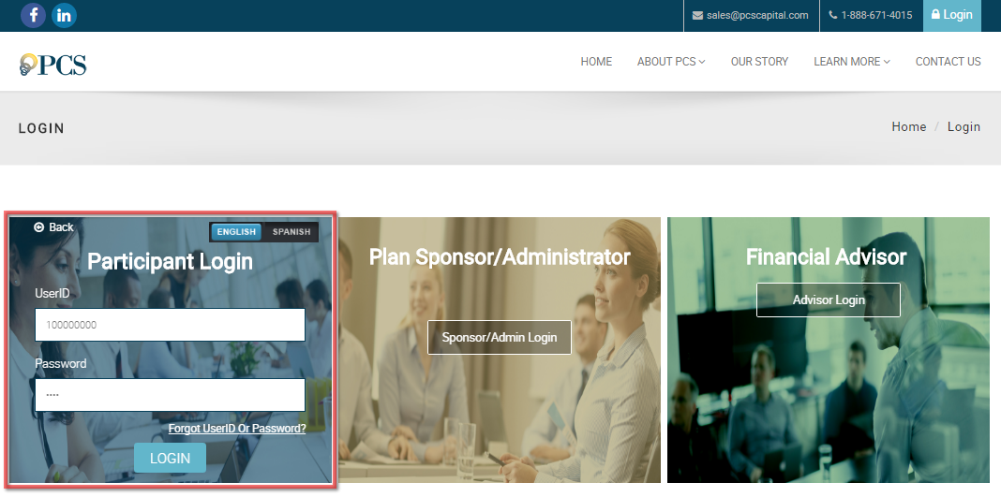
Online Enrollment Process
www.WebAccountLink.com
Initial Username (SSN): XXXXXXXXX
Initial Password (Last 4 Digits of SSN): XXXX

Slide 14
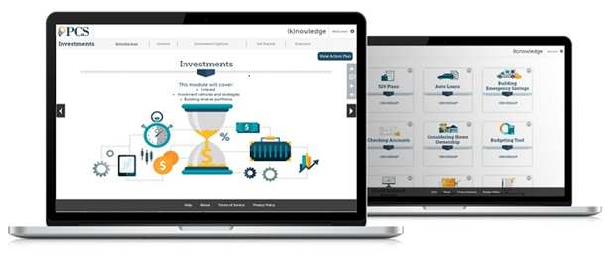
Online Financial Wellness Tools
12 Educational Modules, including:
Budgeting
Savings
Home Ownership
Credit Scores and Reports
Identity Protection
Investments
Mortgages
Retirement 101
Taxes
And more
Offered in both English and Spanish
Video, animation and gaming to engage and participants
2-7 minute modules, designed for today’s busy, on-the- go adult
Accessible on mobile or tablet devices

Slide 15
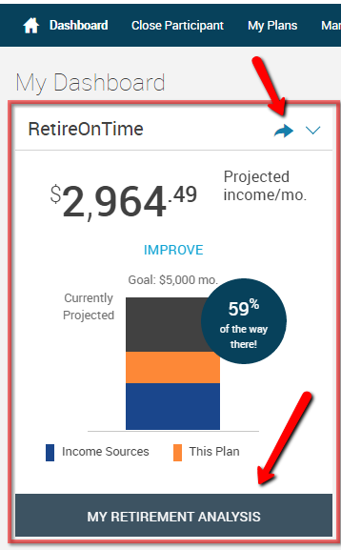
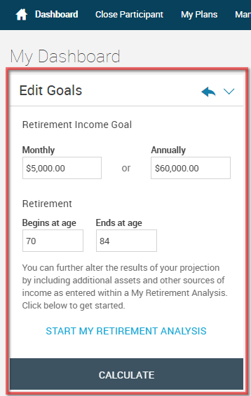
RetireOnTime – Retirement Readiness & Gap Analysis Tool

Slide 16
Disclosures
CliftonLarsonAllen Wealth Advisors, LLC (“CLA Wealth Advisors”)
The purpose of this publication is purely educational and informational. It is not intended to promote any product or service and should not be relied on for accounting, legal, tax, or investment advice. The views expressed are those of CLA Wealth Advisors. They are subject to change at any time. Past performance does not imply or guarantee future results. Investing entails risks, including possible loss of principal. Diversification cannot assure a profit or guarantee against a loss. Investing involves other forms of risk that are not described here. For that reason, you should contact an investment professional before acting on any information in this publication.
Financial information is from third party sources. Such information is believed to be reliable but is not verified or guaranteed. Performances from any indices in this report are presented without factoring fees or charges, and are provided for reference and competitive purposes only. Any fees, charges, or holdings different than the indices will effect individual results. Indexes are unmanaged; one cannot invest directly into an index. Investment Advisory Services offered through CliftonLarsonAllen Wealth Advisors, LLC, an SEC Registered Investment Advisor.
Prior approval is required for further distribution of this material.

Slide 17
Questions?
Rebecca Moore
Wealth Advisor
267-419-1651
Rebecca.moore@CLAconnect.com

